Slide 1
Software Testing
Introduction
Notes:
Workshop on "How to find software faults before our customers find them" Copyright©2007

Slide 2
Unit-I
Introduction: What is software testing and why it is so hard?, Error, Fault,Failure, Incident, Test Cases, Testing Process, Limitations of Testing, No absolute proof of correctness, Overview of Graph Theory.
Unit-II
Functional Testing: Boundary Value Analysis, Equivalence Class Testing,Decision Table Based Testing, Cause Effect Graphing Technique. Structural Testing: Path testing, DD-Paths, Cyclomatic Complexity, Graph Metrics, Data Flow Testing, Mutation testing.
Unit-III
Reducing the number of test cases: Prioritization guidelines, Priority category, Scheme, Risk Analysis, Regression Testing, Slice based testing Testing Activities: Unit Testing, Levels of Testing, Integration Testing, System Testing, Debugging, Domain Testing.
Unit-IV
Object Oriented Testing: Issues in Object Oriented Testing, Class Testing,GUI Testing, Object Oriented Integration and System Testing. Testing Tools: Static Testing Tools, Dynamic Testing Tools, Characteristics of Modern Tools.

Slide 3
Text:
1. William Perry, “Effective Methods for Software Testing”, John Wiley & Sons,New York, 1995.
2. Cem Kaner, Jack Falk, Nguyen Quoc, “Testing Computer Software”, SecondEdition, Van Nostrand Reinhold, New York, 1993.
3. Boris Beizer, “Software Testing Techniques”, Second Volume, Second Edition,Van Nostrand Reinhold, New York, 1990.
4. Louise Tamres, “Software Testing”, Pearson Education Asia, 2002
Reference:
1. Roger S. Pressman, “Software Engineering – A Practitioner’s Approach”, Fifth Edition, McGraw-Hill International Edition, New Delhi, 2001.
2. Boris Beizer, “Black-Box Testing – Techniques for Functional Testing of Software and Systems”, John Wiley & Sons Inc., New York, 1995.
3. K.K. Aggarwal & Yogesh Singh, “Software Engineering”, New Age International Publishers, New Delhi, 2003.
4. Marc Roper, “Software Testing”, McGraw-Hill Book Co., London, 1994.
5. Gordon Schulmeyer, “Zero Defect Software”, McGraw-Hill, New York, 1990.
6. Watts Humphrey, “Managing the Software Process”, Addison Wesley Pub. Co. Inc., Massachusetts, 1989.
7. Boris Beizer, “Software System Testing and Quality Assurance”, Van Nostrand Reinhold, New York, 1984.
8. Glenford Myers, “The Art of Software Testing”, John Wiley & Sons Inc., New York, 1979.

Slide 4
Software Testing
What is software testing ?
Why do we need to test ?
Cannot we live without testing ?
How do we handle software bugs reported by the customers ?
Who should work hard to avoid frustrations of failures ?
The developers normally ask :
How did these bugs escape from testing ?
Notes:
Workshop on "How to find software faults before our customers find them" Copyright©2007

Slide 5
Some Software failures
Ariane 5
It took the European Space Agency 10 years and $7 billion to produce Ariane 5, a giant rocket capable of hurling a pair of three-ton satellites into orbit with each launch and intended to give Europe overwhelming supremacy in the commercial space business.
The rocket was destroyed after 39 seconds of its launch, at an altitude of two and a half miles along with its payload of four expensive and uninsured scientific satellites.
Notes:
Workshop on "How to find software faults before our customers find them" Copyright©2007

Slide 6
Some Software failures
When the guidance system’s own computer tried to convert one piece of data the sideways velocity of the rocket from a 64 bit format to a 16 bit format; the number was too big, and an overflow error resulted after 36.7 seconds.
When the guidance system shutdown, it passed control to an identical, redundant unit, which was there to provide backup in case of just such a failure.
Unfortunately, the second unit had failed in the identical manner, a few milliseconds before.
Read the record report of Prof. J.L. Lions, Chairman Inquiry Board and Director General of ESA prepared on 19th July, 1996 for Identification of the Causes of Failure of Ariane 5:
Notes:
Workshop on "How to find software faults before our customers find them" Copyright©2007

Slide 7
Some Software failures
Y2K problem:
It was simply because of using only last two digits of the year.
The 4 digit date format, like 1964, was shortened to 2 digit format, like 64.
Notes:
Workshop on "How to find software faults before our customers find them" Copyright©2007

Slide 8
Some Software failures
The Patriot Missile
First time used in Gulf war
Used as a defence from Iraqi Scud missiles
Failed several times including one that killed 28 US soldiers in Dhahran, Saudi Arabia
Reasons:
A small timing error in the system’s clock accumulated to the point that after 14 hours, the tracking system was no longer accurate.
In the Dhahran attack, the system had been operating for more than 100 hours.
Notes:
Workshop on "How to find software faults before our customers find them" Copyright©2007

Slide 9
Some Software failures
The Space Shuttle
Part of an abort scenario for the Shuttle requires fuel dumps to lighten the spacecraft.
It was during the second of these dumps that a (software) crash occurred.
The fuel management module, which had performed one dump and successfully exited, restarted when recalled for the second fuel dump...
Notes:
Workshop on "How to find software faults before our customers find them" Copyright©2007

Slide 10
Experience of Windows XP
Released on October 25,2001
Same day company posted 18 megabytes of patches on its website for bug fixes, compatibility updates and enhancements.
Notes:
Workshop on "How to find software faults before our customers find them" Copyright©2007

Slide 11
Testing Process
It is basically the process of testing the newly developed software, prior to actual use.
Good testing involves much more than just running the program a few times to see whether it works as per specifications.
Notes:
Workshop on "How to find software faults before our customers find them" Copyright©2007

Slide 12
What is testing ?
There are many definitions of testing. A few of them are given below:
Testing is the process of demonstrating that errors are not present.
2. The purpose of testing is to show that a program performs its intended functions correctly.
3. Testing is the process of establishing confidence that a program does what it is supposed to do.
Incorrect
Testing
Value to the program
Notes:
Workshop on "How to find software faults before our customers find them" Copyright©2007

Slide 13
Definition
The most appropriate definition is :
“Testing is the process of executing a program with the intent of finding faults.”
Our input selection should have a higher probability of finding faults.
Notes:
Workshop on "How to find software faults before our customers find them" Copyright©2007

Slide 14
What is Software testing ?
Consider a program, minimum() that reads a set of integers and prints the smallest integer.
Notes:
Workshop on "How to find software faults before our customers find them" Copyright©2007

Slide 15
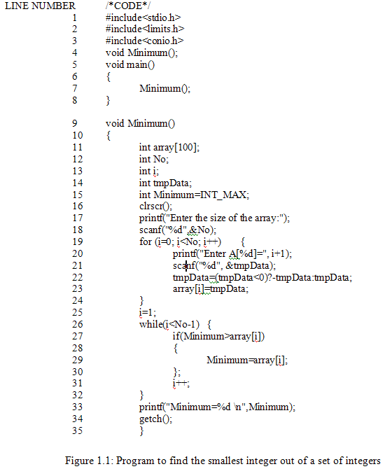
Notes:
Workshop on "How to find software faults before our customers find them" Copyright©2007

Slide 16
What is Software testing ?
.
Some test cases
Sr. No. | Inputs |  | Expected output | Observed output | Match ?
 | Size | Set of integers
1
2
3
4
5
6
7
8
5
6,9,2,16,19
2
2
Yes
7
96,11,32,9,39,99,91
9
9
Yes
7
31,36,42,16,65,76,81
16
16
Yes
6
28,21,36,31,30,38
21
21
Yes
6
106,109,88,111,114,116
88
88
Yes
6
61,69,99,31,21,69
21
21
Yes
4
6,2,9,5
2
2
Yes
4
99,21,7,49
7
7
Yes
Notes:
Workshop on "How to find software faults before our customers find them" Copyright©2007

Slide 17
Situations
In the minimum() program we concentrate on some typical and critical situations :
(i) A very short list (of inputs) with the size of 1,2 or 3 elements.
(ii) An empty list i.e. of size 0.
(iii) A list where the minimum element is the first or last element.
(iv) A list where the minimum element is negative.
(v) A list where all elements are negative.
Cont….
Notes:
Workshop on "How to find software faults before our customers find them" Copyright©2007

Slide 18
Situations
(vi) A list where some elements are real numbers.
(vii) A list where some elements are alphabetic characters.
(viii) A list with duplicate elements.
(ix) A list where one element has a value greater than maximum permissible limit of an integer.
Notes:
Workshop on "How to find software faults before our customers find them" Copyright©2007

Slide 19
Situations
In the previous table, we have selected elements in every list to cover essentially the same situation :
A list of moderate size.
Containing all positive integers.
Minimum is somewhere in the middle.
Notes:
Workshop on "How to find software faults before our customers find them" Copyright©2007

Slide 20
Some critical / typical situations of program Minimum()
Case number with description | Inputs |  |  | Expected o/p | Observed o/p | Match ?
 |  | Size | Set of Integers
a b c d e f
1 2 2 3 3 3
90
12,10
10,12
12,14,36
36,14,12
14,12,36
90 10 10 12 12 12
2147483647
2147483647
2147483647
14
14
12
No No No No No Yes
Case 1
A very short list with size 1,2 or 3
Case 2
An empty list i.e. of size 0
a
0
----
Error message
2147483647
No
Case 3
A list where minimum element is first or last element
a
b
5
5
10,23,34,81,97
97,81,34,23,10
10
10
23
23
No
No
Case 4
A list where minimum element is negative
a
b
4
4
10,-2,5,23
5,-25,20,36
-2
-25
2
20
No
No
Cont….
Notes:
Workshop on "How to find software faults before our customers find them" Copyright©2007

Slide 21
Case number with description | Inputs |  |  | Expected o/p | Observed o/p | Match ?
 |  | Size | Set of Integers
Case 5
A list where all elements are negative
a
b
5
5
-23,-31,-45,-56,-78
-6,-203,-56,-78,-2
-78
-203
31
56
No
No
Case 6
A list where some elements are real numbers
a
b
5
5
12,34.56,6.9,62.14,19
2,3,5,6,9
6.9
2
34 (Program does not take values for index 3,4,5)
838993460 (Program does not take any array value)
No
No
Case 7
A list where some elements are characters
a
b
5
1I
23,2 I,26,6,9
2,3,4,9,6,5,11,12,14,21,22
6
2
2 (No value for index 3,4,5)
2147483647 (Program does not take any index value)
No
No
Case 8
A list with duplicate elements
a
b
5
5
3,4,6,9,6
13,6,6,9,15
3
6
4
6
No
Yes
Case 9
Value greater than maximum permissible limit of an integer
a
5
530,4294967297,23, 46,59
23
1
No
Notes:
Workshop on "How to find software faults before our customers find them" Copyright©2007

Slide 22
What are the possible reasons for so many failures ?
Possible reasons
Case 1
A very short list with size 1,2 or 3
While handling the minimum, the base value of the index and / or end value of the index of the usable array has not been handled properly.
See line no. 25 & 26
Case 2
An empty list i.e. of size 0
Program proceeds without checking the size of the array.
See line 18 & 19
Case 3
A list where minimum element is the first or last element
Same as for case 1
Case 4
A list where minimum element is negative
The program converts all negative integers into positive integers
See line no. 22
Case 5
A list where all elements are negative
Same as for case 4
Cont….
Notes:
Workshop on "How to find software faults before our customers find them" Copyright©2007

Slide 23
What are the possible reasons for so many failures ?
Possible reasons
Case 6
Some elements are real numbers
Scanf() has unpredictable behaviour for inputs not according to specified format.
Case 7
Some elements are alphabetic characters
Same as for case 6
Case 8
A case with duplicate elements
Same as case 1
We are getting correct results because minimum value is in the middle of the list and all values are positive.
Case 9
A list with one value greater than maximum permissible limit of an integer
This is hardware dependent problem. This is the case of the overflow of maximum permissible value of the integer. Here, 32 bits integers are used.
Notes:
Workshop on "How to find software faults before our customers find them" Copyright©2007

Slide 24
Reasons for observed outputs
Cases
Observed
output
Remarks
1 (a)
1 (b)
1 (c)
2147483647
2147483647
2147483647
The program has ignored first & last values of the list. This is the maximum value of a 32 bit integer to which variable minimum is initialized.
1 (d)
1 (e)
14
14
The program has ignored first and last value of the list. Middle value is 14.
1 (f)
12
Ignored first & last value. Fortunately, middle value is minimum & thus the result is correct.
2 (a)
2147483647
Same as 1 (a)
3 (a)
3 (b)
23
23
Ignored first & last value. 23 is the minimum value in the remaining list.
4 (a)
4 (b)
2
20
Ignored first & last value. It has also converted negative integer(s) to positive integer(s).
Cont….
Notes:
Workshop on "How to find software faults before our customers find them" Copyright©2007

Slide 25
Reasons for observed outputs
Cases
Observed
output
Remarks
5 (a)
5 (b)
31
56
Same as case 4
6 (a)
6 (b)
34
858993460
After getting ‘.’ of 34.56, program was terminated & 34 was displayed.12 was ignored due to first value:
For 6(b): Garbage value
7 (a)
7 (b)
2
2147483647
After getting ‘I’, program terminated adruptly.
Maximum value of integer
8 (a)
8 (b)
4
6
Same as case 3
Fortunately result is correct. Although, first & last value are ignored.
9 (a)
1
The program displays this value due to the overflow of the 32 bit signed integer data type used in the program
Notes:
Workshop on "How to find software faults before our customers find them" Copyright©2007

Slide 26
Modification in the program minimum ()
1. The program has ignored the first & last values of the list.
Line no. 25 & 26
Two faults
25 “i=1;” “i=0;”
26 “while (i<No-1)” “while (i<=No-1)”
2. The program proceeds without checking the size of the array
Line no. 17 & 18
After line 18
If (No <=0)
{
printf (“Invalid size specified”);
}
Notes:
Workshop on "How to find software faults before our customers find them" Copyright©2007

Slide 27
Modification in the program minimum ()
3. Program has converted negative values to positive values
Line no. 22
Delete this line
Modified program in fig. 2
Notes:
Workshop on "How to find software faults before our customers find them" Copyright©2007

Slide 28
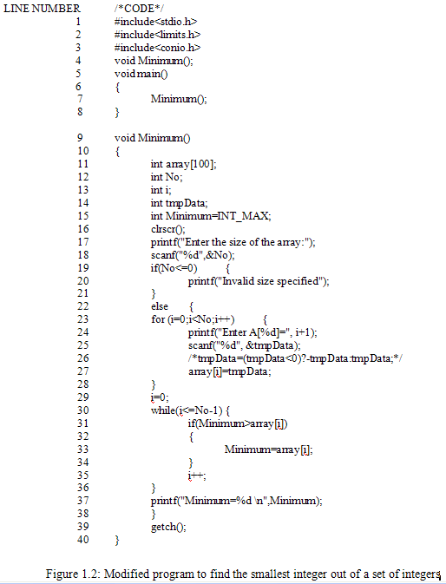
Notes:
Workshop on "How to find software faults before our customers find them" Copyright©2007

Slide 29
Results of modified program
Case number with description | Inputs |  |  | Expected o/p | Observed o/p | Match ?
 |  | Size | Set of Integers
a b c d e f
1 2 2 3 3 3
90
12,10
10,12
12,14,36
36,14,12
14,12,36
90 10 10 12 12 12
90
10
10
12
12
12
Yes
Yes
Yes
Yes
Yes
Yes
Case 1
A very short list with size 1,2 or 3
Case 2
An empty list i.e. of size 0
a
----
Error message
Error message
0
Yes
Case 3
A list where minimum element is first or last element
a
b
5
5
10,23,34,81,97
97,81,34,23,10
10
10
10
10
Yes
Yes
Case 4
A list where minimum element is negative
a
b
4
4
10,-2,5,23
5,-25,20,36
-2
-25
-2
-25
Yes
Yes
Cont….
Notes:
Workshop on "How to find software faults before our customers find them" Copyright©2007

Slide 30
Case number with description | Inputs |  |  | Expected o/p | Observed o/p | Match ?
 |  | Size | Set of Integers
Case 5
A list where all elements are negative
a
b
5
5
-23,-31,-45,-56,-78
-6,-203,-56,-78,-2
-78
-203
-78
-203
Yes
Yes
Case 6
A list where some elements are real numbers
a
b
5
5.4
12,34.56,6.9,62.14,19
2,3,5,6,9
6.9
2
12
838993460 (Program does not take any array value)
No
No
Case 7
A list where some elements are characters
a
b
5
1I
23,2 I,26,6,9
2,3,4,9,6,5,11,12,14,21,22
6
2
2 (No value for index 3,4,5)
2147483647 (Program does not take any index value)
No
No
Case 8
A list with duplicate elements
a
b
5
5
3,4,6,9,6
13,6,6,9,15
3
6
3
6
Yes
Yes
Case 9
Value greater than maximum permissible limit of an integer
a
5
530,4294967297,23, 46,59
23
1
No
Notes:
Workshop on "How to find software faults before our customers find them" Copyright©2007

Slide 31
Results of modified program
Case 6 & case 7 are failed due to scanf() function parsing problem
Do not use scanf()
If use scanf(), display a warning message for the user before using scanf()
Notes:
Workshop on "How to find software faults before our customers find them" Copyright©2007

Slide 32
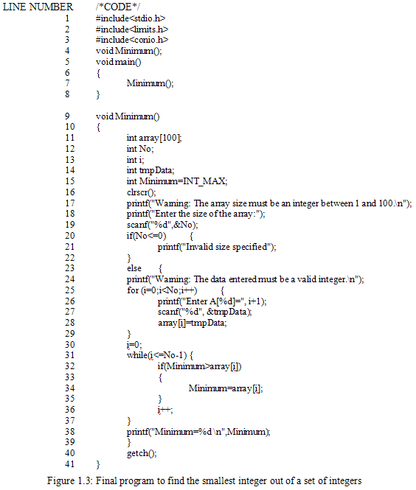
Notes:
Workshop on "How to find software faults before our customers find them" Copyright©2007

Slide 33
Objective
Objective is to identify weak areas.
Most appropriate definition is :
Testing is the process of executing a program with the intent of finding faults.
Notes:
Workshop on "How to find software faults before our customers find them" Copyright©2007

Slide 34
Why should we test ?
Software testing is expensive
not testing is more expensive and dangerous
Running a car without brakes
How much testing ?
Do we have methods to know it?
Do we have techniques to quantify it ?
Notes:
Workshop on "How to find software faults before our customers find them" Copyright©2007

Slide 35
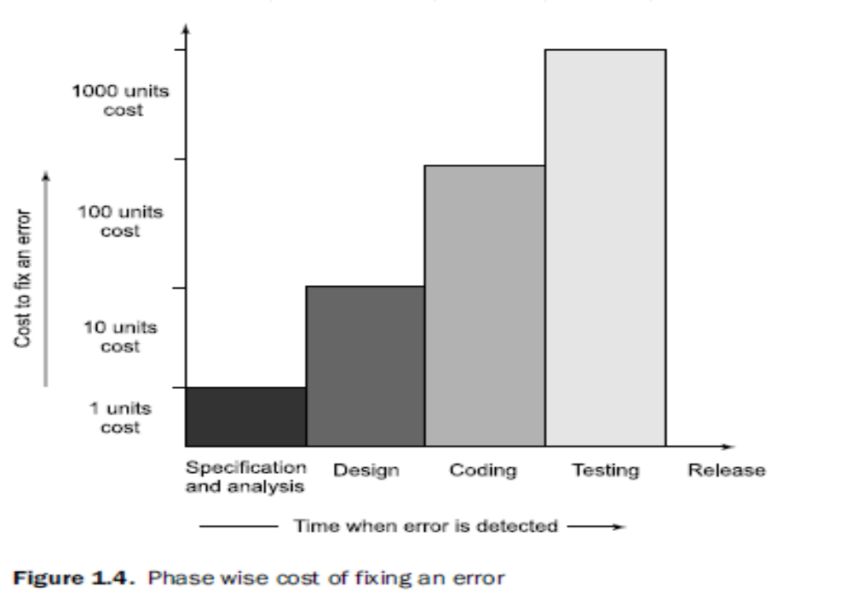
The cost to fix errors increases drastically from specification phase to test phase & then to maintenance phase.
When should testing be done?
Notes:
Workshop on "How to find software faults before our customers find them" Copyright©2007

Slide 36
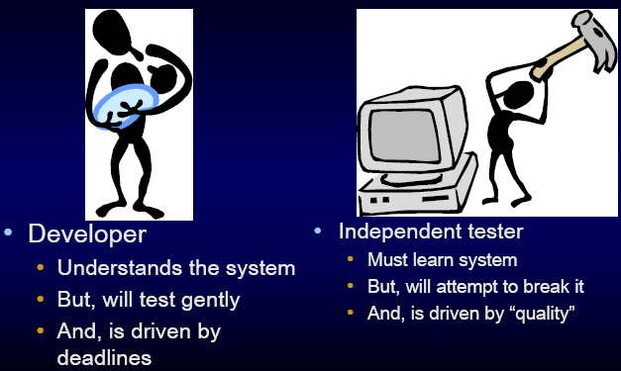
Who should do testing ?
Team work
Depends on complexity & size of the project
Notes:
Workshop on "How to find software faults before our customers find them" Copyright©2007

Slide 37
Who should do testing ?
Developers should have a reduced role in testing
Testing persons should be curious, critical but non judge mental and good communicators.
Testers may ask questions that developers might find not be able to ask themselves or are awkward, irritating, insulting or even threatening to the developers.
Most of the times, testing persons are different from developers.
Developers provide guidelines during testing.
Notes:
Workshop on "How to find software faults before our customers find them" Copyright©2007

Slide 38
Role of Persons
Sr. No. | Persons | Roles
1
2
3
4
5
Customer
Provides funding, give requirements, approve changes & some test results.
Project Manager
Plans & manages the project.
Software developer (s)
Design, codes & builds the software, participates in code reviews & testing, fixes bugs, defects & short comings.
Testing
Co-ordinator (s)
Create test plans & test specifications based on the requirements and functional and technical documents.
Testing persons (s)
Execute the tests and documents results.
Notes:
Workshop on "How to find software faults before our customers find them" Copyright©2007

Slide 39
What should we test ?
We should test the program’s responses to every possible input.
All valid inputs
Invalid inputs
Suppose a program requires two 8 bits integers as inputs.
Total combinations = 2⁸ x 2⁸
Time required to execute a test case = 1second
Total time = 18 hours
Notes:
Workshop on "How to find software faults before our customers find them" Copyright©2007

Slide 40
What should we test ?
How to choose reasonable number of test cases out of large pool of test cases?
What is the bottom line for testing?
Execute every statement at least once
Execute every possible path at least once
Execute every exit of branch statement at least once
Notes:
Workshop on "How to find software faults before our customers find them" Copyright©2007

Slide 41
What should we test ?
Executing every statement of the program at least once may seem to be a reasonable goal.
However, many portions of the program may be missed with this type of criteria.
Notes:
Workshop on "How to find software faults before our customers find them" Copyright©2007

Slide 42
Consider the following piece
of code:
This code can be represented graphically as:
If (x>0)
{
a=a+b;
}
If (y>10)
{
c=c+d;
}
A
C
B
E
D

Slide 43
Line Numbers | Symbol for representation
1
A
2,3,4
B
5
C
6,7,8
D
end
E
Notes:
Workshop on "How to find software faults before our customers find them" Copyright©2007

Slide 44
What should we test ?
What are the possible paths in this graph???
The possible paths are: ACE, ABCE, ACDE and ABCDE
How many test cases are sufficient for 100% statement coverage??
If we choose x=9 and y=15, all statements are covered.
Hence, only one test case is sufficient for 100% statement coverage.
But we have missed other three paths.
Therefore this coverage may not be sufficient, even that may also be difficult to achieve in the real life programs.
Notes:
Workshop on "How to find software faults before our customers find them" Copyright©2007

Slide 45
What should we test ?
Another dimension is to execute all possible paths of the program.
A program path can be traced through the code from the start of the program to program termination.
Two paths differ if the program executes different statements in each, or executes the same statements but in different order. A program may have many paths.
Notes:
Workshop on "How to find software faults before our customers find them" Copyright©2007

Slide 46
Sequences
B
A
F
D
G
C
X
EXIT
H
E
I
< 20 times
through the
loop
Here’s an example that shows that there are too many paths to test in even a fairly simple program. This is from Myers, The Art of Software Testing.
Notes:
Workshop on "How to find software faults before our customers find them" Copyright©2007

Slide 47
Sequences
B
A
F
D
G
C
X
EXIT
H
E
I
< 20 times
through the
loop
There are 5 ways to get from A to X. One of them is ABX--EXIT
Notes:
Workshop on "How to find software faults before our customers find them" Copyright©2007

Slide 48
Sequences
B
A
F
D
G
C
X
EXIT
H
E
I
< 20 times
through the
loop
A second path is ACDFX--EXIT
Notes:
Workshop on "How to find software faults before our customers find them" Copyright©2007

Slide 49
Sequences
B
A
F
D
G
C
X
EXIT
H
E
I
< 20 times
through the
loop
Third: ACDGX--EXIT
Notes:
Workshop on "How to find software faults before our customers find them" Copyright©2007

Slide 50
Sequences
B
A
F
D
G
C
X
EXIT
H
E
I
< 20 times
through the
loop
Fourth: ACEHX--EXIT
Notes:
Workshop on "How to find software faults before our customers find them" Copyright©2007

Slide 51
Sequences
B
A
F
D
G
C
X
EXIT
H
E
I
< 20 times
through the
loop
Fifth: ACEIX--EXIT. There are 5 ways to get from A to the EXIT if you go through X only once.
Notes:
Workshop on "How to find software faults before our customers find them" Copyright©2007

Slide 52
Sequences
B
A
F
D
G
C
X
EXIT
H
E
I
< 20 times
through the
loop
But we can go through X more than once. Here’s another path. ACEHXABX--EXIT.
Notes:
Workshop on "How to find software faults before our customers find them" Copyright©2007

Slide 53
Sequences
B
A
F
D
G
C
X
EXIT
H
E
I
< 20 times
through the
loop
There are 5 ways to get to X the first time, 5 more to get back to X the second time, so there are 5 x 5 = 25 cases for reaching EXIT by passing through X twice.
Notes:
Workshop on "How to find software faults before our customers find them" Copyright©2007

Slide 54
Sequences
Analyzing Myers’ example
There are 5¹ + 5² + ... + 5¹⁹ + 5²⁰ = 10¹⁴ = 100 trillion paths through the program.
It would take only a billion years to test every path (if one could write, execute and verify a test case every five minutes).
Notes:
Workshop on "How to find software faults before our customers find them" Copyright©2007

Slide 55
The Impossibility Of Testing Everything
In his monumental book Testing Object-Oriented Systems, Robert Binder provides an excellent example of the impossibility of testing "everything."
Consider the following program:
int blech (int j)
{
j = j -1; // should be j = j + 1
j = j / 30000;
return j;
}
Notes:
Workshop on "How to find software faults before our customers find them" Copyright©2007

Slide 56
The Impossibility Of Testing Everything
Note that the second line is incorrect! The function blech accepts an integer j, subtracts one from it, divides it by 30000 (integer division, whole numbers, no remainder) and returns the value just computed.
If integers are implemented using 16 bits on this computer executing this software, the lowest possible input value is -32768 and the highest is 32767. Thus there are 65,536 possible inputs into this tiny program.
Will you have the time (and the stamina) to create 65,536 test cases? Of course not.
So which input values do we choose?
Consider the following input values and their ability to detect this defect.
Notes:
Workshop on "How to find software faults before our customers find them" Copyright©2007

Slide 57
Input (j) | Expected Result | Actual Result
1
0
0
42
0
0
40000
1
1
-64000
-2
-2
Note that none of the test cases chosen have detected this defect.
In fact only four of the possible 65,536 input values will find this defect.
What is the chance that we will choose all four?
What is the chance we will choose one of the four?
Notes:
Workshop on "How to find software faults before our customers find them" Copyright©2007

Slide 58
30000
29999
-29999
-30000

Slide 59
Limitation of Testing:::
Complete Testing Is Impossible
the space to search is vast...
...and your resources are a constraint.
Notes:
Workshop on "How to find software faults before our customers find them" Copyright©2007

Slide 60
Complete testing?
What do we mean by "complete testing"?
Complete "coverage": Tested every line / branch / basis path?
Testers not finding new bugs?
Test plan complete?
After all, if there are more bugs, you can find them if you do more testing. So testing couldn't yet be "complete."
Complete testing must mean that, at the end of
testing, you know there are no remaining
unknown bugs.
Notes:
Workshop on "How to find software faults before our customers find them" Copyright©2007

Slide 61
The Limitation Of Testing
There is a popular belief that we can test a program completely:
Some junior level programming texts even claim to tell us how to do it: Test the program’s response to all possible inputs, or test all possible paths through the program.
Notes:
Workshop on "How to find software faults before our customers find them" Copyright©2007

Slide 62
The Limitation Of Testing
Many managers also believe in the possibility of complete testing. They even order the staff to do it, and assure each other that it is being done.
Sales brochures from some software testing companies promise that they will fully test our code.
Test coverage analyzers are sometimes marketed with the promise of telling us, whether we have fully tested the code, and what further testing we must do to achieve complete testing.
Many salespeople believe their software products are fully tested and error free, and pass on this claim to customers.
Notes:
Workshop on "How to find software faults before our customers find them" Copyright©2007

Slide 63
The Limitation Of Testing
No matter, how hard we try, how cleverly we plan, how much time we spend, and how many staff and computers we use, we still can not do enough testing. We still miss bugs. Some of the reasons are:
The domain of possible inputs is too large to test
There are too many possible paths through the program to test
The user interface issues (and thus the design issues) are too complex to completely test.
If “3+3 should be 7” is written in specifications, and program gives output of 7 (instead of 6); is it a bug?
Notes:
Workshop on "How to find software faults before our customers find them" Copyright©2007

Slide 64
Measurement of the progress of testing
What is the status of testing ?
We count things
How to interpret such counts ?
Is experiencing more failures a good news or a bad ?
The answer could be either.
Notes:
Workshop on "How to find software faults before our customers find them" Copyright©2007

Slide 65
Measurement of the progress of testing
Is high bug count a measure of the progress of testing????
A high bug count could mean that testing was thorough and very few bugs remain. Or,
it could mean that the software simply has lots of bugs and, even though many have been exposed, lots of them remain.
These counts may be illusive and do not help us to measure the progress of testing.
Notes:
Workshop on "How to find software faults before our customers find them" Copyright©2007

Slide 66
Measurement of the progress of testing
When should we release the software??
When to release the software is a sensitive decision & should be based on the status of testing.
Although in the absence of testing standards,
  “economics”,
  “time to market” and
  “gut feeling”
have become important issues over technical considerations for the release of any software.
Many reliability models are available with many limitations and are not universally acceptable.

Slide 67
Software Testing
Error, Mistake, Bug, Fault and Failure
People make errors. A good synonym is mistake.
This may be a syntax error or misunderstanding of specifications. Sometimes, there are logical errors.
When people make mistakes while coding, we call these mistakes “bugs”.
Errors tend to propagate; a requirements error may be magnified during design and amplified still more during coding.
Notes:
Workshop on "How to find software faults before our customers find them" Copyright©2007

Slide 68
Software Testing
A fault is the result of an error.
A fault is the representation of an error, where representation is the mode of expression, such as narrative text, Unified Modeling Language diagrams, hierarchy charts, and source code etc.
Defect is a good synonym for fault and bug (as per ISTQB)
International Software Testing Qualifications Board
Notes:
Workshop on "How to find software faults before our customers find them" Copyright©2007

Slide 69
We have faults of commission and faults of omission.
An error of omission results in a fault in which something is missing that should be present in the representation.
A fault of commission occurs when we enter something into a representation that is incorrect.
Faults of omission occur when we fail to enter correct information.
Of these two types, faults of omission are more difficult to detect and resolve.

Slide 70
Incident—When a failure occurs, it may or may not be readily apparent to the user (or customer or tester).
An incident is the symptom associated with a failure that alerts the user to the occurrence of a failure.
A failure occurs when a fault executes.
A particular fault may cause different failures, depending on how it has been exercised.

Slide 71
The failures only occur in an executable representation, which is usually taken to be source code, or more precisely, loaded object code.
This definition relates failures only to faults of commission
How can we deal with failures that correspond to faults of omission?
What about faults that never happen to execute, or perhaps do not execute for a long time?
Reviews prevent many failures by finding faults; in fact, well-done reviews can find faults of omission

Slide 72
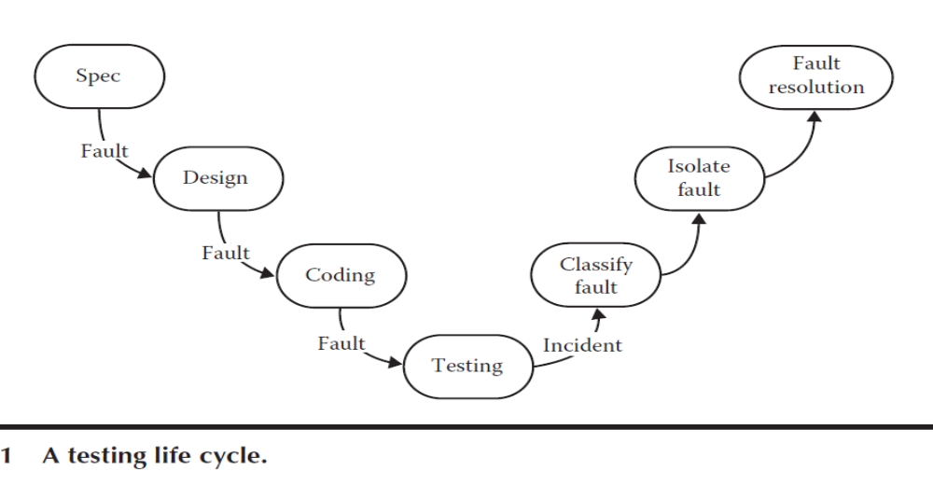
Test—Testing is obviously concerned with errors, faults, failures, and incidents. A test is the act of exercising software with test cases.
A test has two distinct goals:
to find failures or
to demonstrate correct execution.

Slide 73
As per ISTQB
Error /Mistake
A human action that produces an incorrect result.
A bug/defect/fault
An imperfection or deficiency in a work product where it does not meet its requirements or specifications.
Failure
An event in which a component or system does not perform a required function within specified limits.

Slide 74
How do we deal with Errors and Faults?
Notes:
Workshop on "How to find software faults before our customers find them" Copyright©2007

Slide 75
Verification and Validation
Verification and Validation
Verification: (as defined by IEEE/ANSI)
It is a process of evaluating a system or component to determine whether the products of a given development phase satisfy the conditions imposed at the start of that phase.
Verification is the process of evaluating, reviewing, inspecting and doing desk checks of work products such as requirement specifications, design specification and code.
It can be applied to all those things that can be reviewed in the early phases to make sure that what comes out of that phase is what we expected to get.
It is a ‘human testing’ as it involves looking at the documents on paper.
Notes:
Workshop on "How to find software faults before our customers find them" Copyright©2007

Slide 76
Verification and Validation
Validation: (as defined by IEEE/ANSI)
It is a process of evaluating a system or component during or at the end of development process to determine whether it satisfies the specified requirements.
It involves executing the actual software.
It is a computer based testing process.
  Testing = Verification + Validation
Notes:
Workshop on "How to find software faults before our customers find them" Copyright©2007

Slide 77
Verification and Validation
Verification and validation are complementary: The effectiveness of error detection suffers if one or the other is not done.
Each of these provides filters that are designed to catch different kinds of problems in the product.
Historically: Testing has been largely validation oriented.
Notes:
Workshop on "How to find software faults before our customers find them" Copyright©2007

Slide 78
Software Testing
Test, Test Case and Test Suite
Test and Test case terms are used interchangeably. In practice, both are same and are treated as synonyms. Test case describes an input description and an expected output description.
Test Case ID
Section-I (Before Execution) | Section-II (After Execution)
Purpose : | Execution History:
Pre condition: (If any) | Result:
Inputs: | If fails, any possible reason (Optional);
Expected Outputs: | Any other observation:
Post conditions: | Any suggestion:
Written by: | Run by:
Date: | Date:
Fig. 2: Test case template
The set of test cases is called a test suite. Hence any combination of test cases may generate a test suite.
Notes:
Workshop on "How to find software faults before our customers find them" Copyright©2007

Slide 79
Alpha, Beta and Acceptance Testing
The term Acceptance Testing is used when the software is developed for a specific customer.
A series of tests are conducted to enable the customer to validate all requirements.
These tests are conducted by the end user / customer and may range from adhoc tests to well planned systematic series of tests.
Notes:
Workshop on "How to find software faults before our customers find them" Copyright©2007

Slide 80
The terms alpha and beta testing are used when the software is developed as a product for anonymous customers.
Alpha Tests are conducted at the developer’s site by some potential customers.
These tests are conducted in a controlled environment.
Alpha testing may be started when formal testing process is near completion.

Slide 81
Beta Tests are conducted by the customers / end users at their sites.
Unlike alpha testing, developer is not present here.
Beta testing is conducted in a real environment that cannot be controlled by the developer.

Slide 82
Software Testing
Static and Dynamic Testing
Static Testing should be started at earlier phases of software development and gives very good results at reasonable cost.
Dynamic Testing refers to execute the code and see how it performs with specific inputs.
All validation activities come in this category where execution of program is essential.
Static Testing refers to testing activities without executing the code.
All verification activities like inspections, walkthroughs, reviews etc come under this category of testing.
Notes:
Workshop on "How to find software faults before our customers find them" Copyright©2007

Slide 83
Software Testing
Testing and Debugging
The purpose of testing is to find faults and find them as early as possible.
The process used to determine the cause of the fault and to remove it is known as debugging.
Notes:
Workshop on "How to find software faults before our customers find them" Copyright©2007

Slide 84
Lectures 2

